Slide 1
AI enhanced dual server public key encryption for secure cloud
TEAM
ARUN S 1RN23CY401
BK PRAMILA 1RN23CY402
CHANDAN GK 1RN23CY404
Guide
Mrs. LIKITHA R
Designation
Department of Computer Science and Engineering (Cyber Security)

Slide 2





Tribute to Our Founder
Our leaders
Dr. R N Shetty
Founder
1928 - forever

Slide 3
Agenda
Introduction
Problem Statement
Objectives
Literature Survey Summary
Existing System & Challenges
Proposed System
System Architecture Diagram
Data Flow Diagram (DFD)
Use Case Diagram
Modules
Technologies Used
Gantt Chart
Future Scope
Conclusion
References

Slide 4
Introduction
Cloud computing is widely used for data storage but faces security challenges like unauthorized access and keyword guessing attacks (KGA).
Traditional public key encryption (PKE) methods are inefficient for secure and fast cloud search.
This project introduces an AI-enhanced dual-server encryption system to improve security and search efficiency.
Key Features:
AI-driven keyword search optimization for faster and accurate retrieval.
Dual-server architecture to prevent direct access to encrypted data.
Post-quantum cryptography (optional) for future-proof security.
Ensures end-to-end encryption, protecting both stored data and search queries in the cloud.

Slide 5
Problem Statement
Cloud storage is vulnerable to unauthorized access, data breaches, and keyword guessing attacks (KGA).
Traditional encryption methods (like RSA & DSA) are inefficient for secure and fast search operations.
Existing systems allow direct access to encrypted data, increasing security risks.
Keyword-based search in encrypted data is slow and prone to attacks.
There is no integration of AI to optimize search operations and detect anomalies.
Future quantum computing advancements could break conventional encryption, making cloud security weaker.

Slide 6
Objectives
Enhance cloud security using AI-driven public key encryption.
Prevent unauthorized access and Keyword Guessing Attacks (KGA).
Implement dual-server architecture to separate search processing and verification.
Optimize keyword search using AI to reduce redundancy and improve efficiency.
Ensure end-to-end encryption for both stored data and search queries.
Explore post-quantum cryptography for future-proof security against quantum threats.

Slide 7
Literature Survey
Paper Title | Authors | Year | Methodology/ Approach | Advantages | Disadvantages
Searchable public-key encryption with cryptographic reverse firewalls for cloud storage | Zhou, Y., Hu, Z., & Li, F. | 2021 | Searchable public key encryption with cryptographic reverse firewalls to prevent unauthorized keyword attacks. | Enhanced security against keyword guessing attacks. | Higher computational cost compared to traditional encryption.
Integrating encryption techniques for secure data storage in the cloud | Seth, B., Dalal, S., Jaglan, V., Le, D. N., Mohan, S., & Srivastava, G. | 2022 | Combination of multiple encryption techniques for cloud security. | Better protection against brute-force attacks. | Increased processing overhead.
Secure data integrity check based on verified public key encryption with equality test for multi-cloud storage | Li, W., Susilo, W., Xia, C., Huang, L., Guo, F., & Wang, T. | 2024 | Public key encryption with an equality test for integrity verification across multiple cloud servers. | Ensures data integrity and correctness. | Limited scalability for large cloud infrastructures.

Slide 8
Literature Survey
Paper Title | Authors | Year | Methodology/ Approach | Advantages | Disadvantages
Improved End-to-End Data Security Approach for Cloud Computing | Ghosh, S., Verma, S. K., Ghosh, U., & Al-Numay, M. | 2023 | End-to-end encryption model to enhance cloud security. | Enhanced confidentiality and data protection. | May increase latency in data retrieval.
Injection attacks against end-to-end encrypted applications | Fábrega, A., Pérez, C. O., Namavari, A., Nassi, B., Agarwal, R., & Ristenpart, T. | 2024 | Analysis of injection attacks in encrypted applications and proposed mitigation strategies. | Identifies key vulnerabilities and solutions for encryption-based systems. | Focuses on application-level security rather than cloud infrastructure.
DssP: Efficient dual-server secret sharing protocol based on password authentication for cloud storage services | Zhang, S., Yong, X., Luo, M., He, D., & Choo, K. K. R. | 2021 | Dual-server secret sharing protocol using password authentication. | Improved security and efficiency for password-based encryption. | Password dependency may pose a risk if credentials are compromised.

Slide 9
Literature Survey
Paper Title | Authors | Year | Methodology/ Approach | Advantages | Disadvantages
A designated cloud server-based multi-user certificateless public key authenticated encryption with conjunctive keyword search against IKGA | Chenam, V. B., & Ali, S. T. | 2022 | Certificateless public key encryption with conjunctive keyword search to defend against keyword guessing attacks. | Prevents unauthorized keyword search and mitigates IKGA risks. | Relatively new approach; requires further validation.
A Fast Searchable Encryption Scheme Based on Dual Servers | Shuquan, L., Xi, Z., & Ruojie, L. | 2024 | Fast encryption scheme utilizing dual servers for secure search. | Accelerates secure search operations while maintaining confidentiality. | Requires more computational resources for implementation.
Public Key Encryption with Authorized Equality Test on Outsourced Ciphertexts for Cloud‐Assisted IoT in Dual Server Model | Zhao, M., Ding, Y., Tang, S., Liang, H., & Wang, H. | 2022 | Public key encryption supporting equality testing for cloud-assisted IoT. | Facilitates secure and efficient data access in IoT environments. | Limited applicability outside IoT scenarios.

Slide 10
Literature Survey
Paper Title | Authors | Year | Methodology/ Approach | Advantages | Disadvantages
Privacy-Preserving Data Search in Cloud Storage | Huang, C., & Shen, X. | 2024 | Privacy-preserving searchable encryption techniques for cloud storage. | Enhances data privacy while enabling efficient search. | May introduce additional computational overhead in large datasets.

Slide 11
Existing System & Challenges
Uses traditional public key encryption (PKE) like RSA & DSA, which are vulnerable to attacks.
Single-server architecture allows direct interaction with encrypted data, increasing security risks.
Keyword-based search is inefficient, leading to slow retrieval times and higher computational costs.
Prone to Keyword Guessing Attacks (KGA), allowing attackers to infer stored data.
Lacks AI-driven optimization and post-quantum security, making it unprepared for future threats.

Slide 12
Proposed System
Implements an AI-enhanced dual-server encryption model for secure cloud storage and search.
AI-driven keyword search optimization reduces redundancy and improves retrieval speed.
Dual-server architecture ensures:
Server 1: Processes encrypted search requests.
Server 2: Verifies keyword authenticity before allowing data retrieval.
Prevents direct access to encrypted data, reducing security risks.
Post-quantum cryptography (optional) adds future-proof security against quantum threats.
Ensures end-to-end encryption, making cloud search both efficient and highly secure.

Slide 13
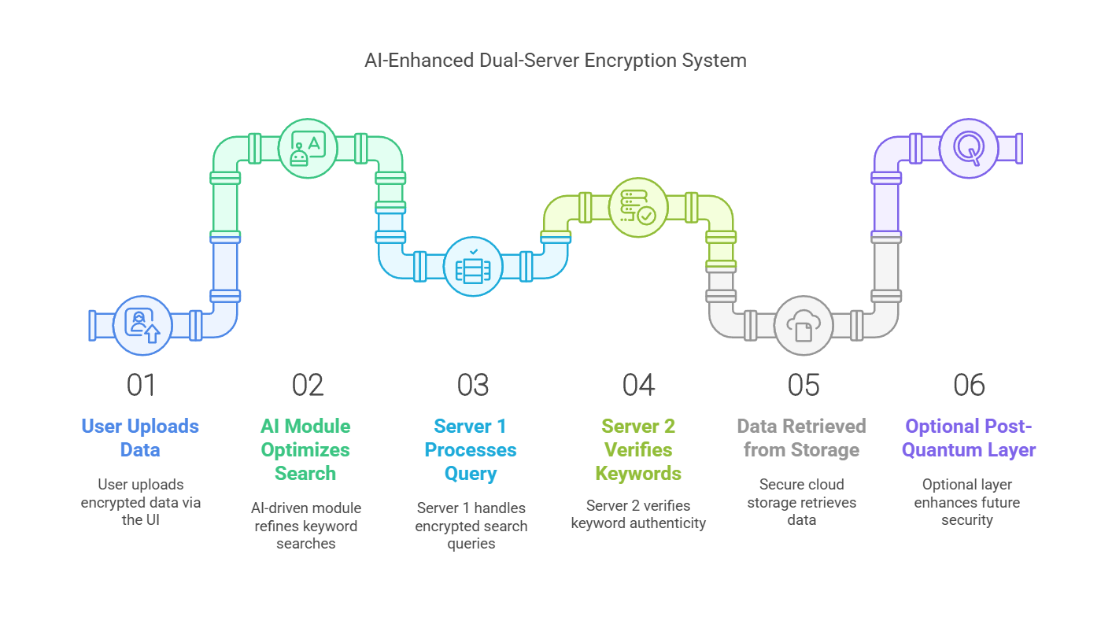
Architecture Diagram

Slide 14
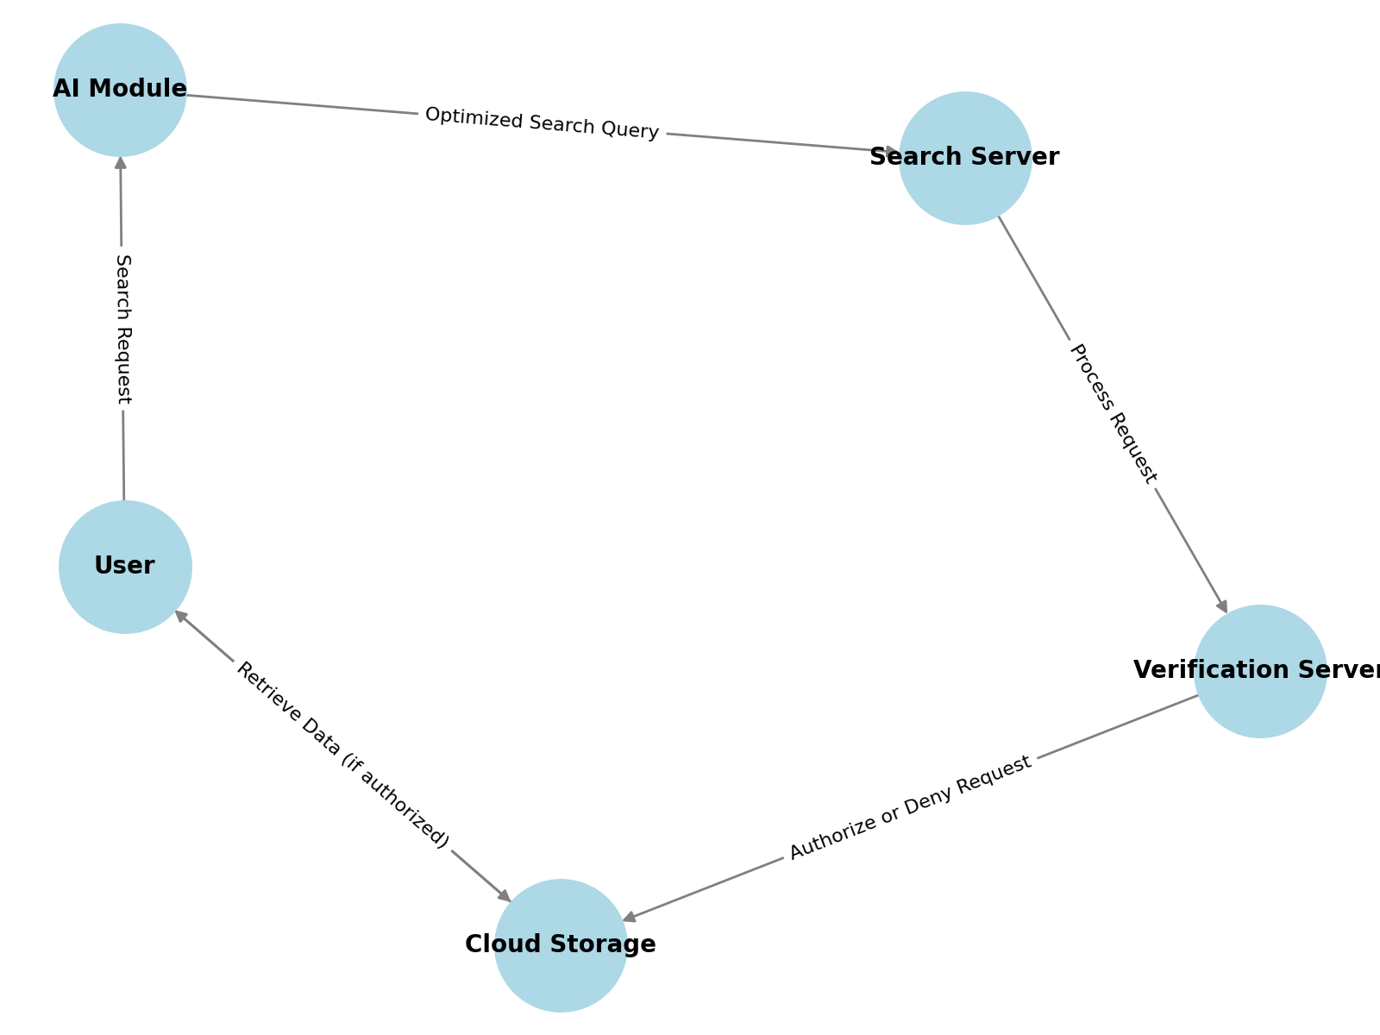
Data Flow Diagram (DFD)

Slide 15
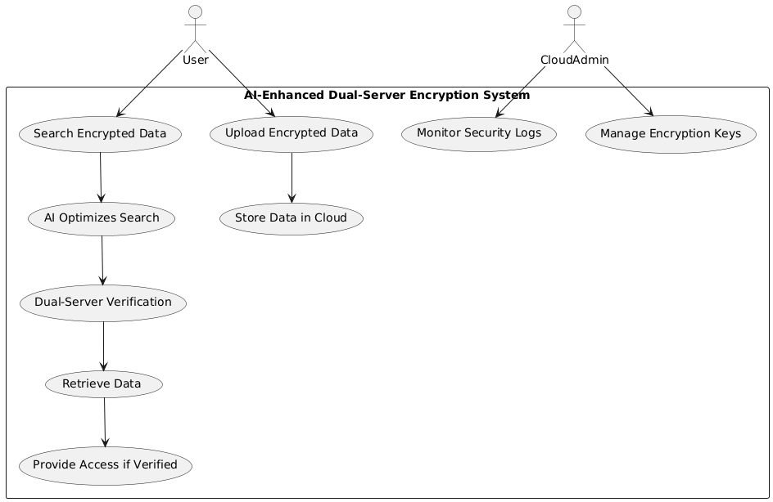
Use Case Diagram

Slide 16
Modules
Data Encryption & Storage → Encrypts data before storing it securely in the cloud.
AI-Driven Search Optimization → AI refines search queries for faster and more efficient retrieval.
Dual-Server Search Execution → Ensures secure search by splitting processing and verification.
Post-Quantum Cryptography (Optional) → Enhances security against future quantum threats.
Secure Search & Data Retrieval → Retrieves only authorized and relevant data while ensuring end-to-end encryption.

Slide 17
Technologies / Languages Used
Programming Language: Python / Java
Machine Learning: TensorFlow / Scikit-Learn
Cloud Storage: AWS / Google Cloud
Encryption: Elliptic Curve Cryptography (ECC), Lattice-based Cryptography (Post-Quantum)
Frameworks: Flask / Django for Web Interface
Database: MySQL / NoSQL

Slide 18
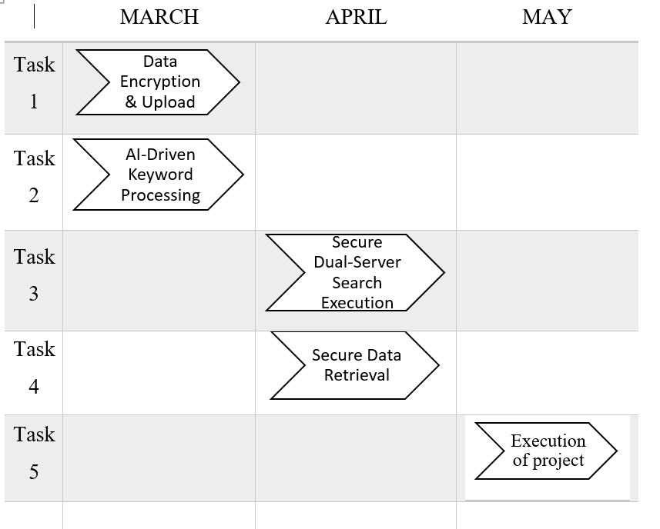
Gantt Chart

Slide 19
Conclusion
AI-Enhanced Dual-Server Encryption for Secure Cloud Search (AI-DS-PEKS) ensures robust security and efficiency in cloud-based data retrieval.
By integrating AI-driven keyword optimization, dual-server verification, and post-quantum cryptography, the system enhances search accuracy while preventing unauthorized access.
The encryption model guarantees confidentiality, safeguarding sensitive data from threats like Keyword Guessing Attacks (KGA).

Slide 20
Future scope
Future enhancements may include adaptive AI models that continuously refine keyword optimization for evolving search patterns. Expansion to hybrid and multi-cloud environments can ensure broader applicability and resilience.
Advanced post-quantum cryptographic techniques can be further explored to counteract emerging quantum computing threats. Blockchain integration could offer enhanced data integrity and transparency in search transactions.

Slide 21
References
Zhou, Y., Hu, Z., & Li, F. (2021). Searchable public-key encryption with cryptographic reverse firewalls for cloud storage. IEEE Transactions on Cloud Computing, 11(1), 383-396.
Seth, B., Dalal, S., Jaglan, V., Le, D. N., Mohan, S., & Srivastava, G. (2022). Integrating encryption techniques for secure data storage in the cloud. Transactions on Emerging Telecommunications Technologies, 33(4), e4108.
Li, W., Susilo, W., Xia, C., Huang, L., Guo, F., & Wang, T. (2024). Secure data integrity check based on verified public key encryption with equality test for multi-cloud storage. IEEE transactions on dependable and secure computing.
Ghosh, S., Verma, S. K., Ghosh, U., & Al-Numay, M. (2023). Improved End-to-End Data Security Approach for Cloud Computing. Sustainability, 15(22), 16010.
Fábrega, A., Pérez, C. O., Namavari, A., Nassi, B., Agarwal, R., & Ristenpart, T. (2024, May). Injection attacks against end-to-end encrypted applications. In 2024 IEEE Symposium on Security and Privacy (SP) (pp. 2648-2665). IEEE.

Slide 22
References
Zhang, S., Yong, X., Luo, M., He, D., & Choo, K. K. R. (2021). DssP: Efficient dual-server secret sharing protocol based on password authentication for cloud storage services. IEEE Systems Journal, 16(2), 2172-2182.
Chenam, V. B., & Ali, S. T. (2022). A designated cloud server-based multi-user certificateless public key authenticated encryption with conjunctive keyword search against IKGA. Computer Standards & Interfaces, 81, 103603.
Shuquan, L., Xi, Z., & Ruojie, L. (2024, December). a Fast Searchable Encryption Scheme Based on Dual Servers. In 2024 21st International Computer Conference on Wavelet Active Media Technology and Information Processing (ICCWAMTIP) (pp. 1-7). IEEE.
Zhao, M., Ding, Y., Tang, S., Liang, H., & Wang, H. (2022). Public Key Encryption with Authorized Equality Test on Outsourced Ciphertexts for Cloud‐Assisted IoT in Dual Server Model. Wireless Communications and Mobile Computing, 2022(1), 4462134.
Zhang, S., Yong, X., Luo, M., He, D., & Choo, K. K. R. (2021). DssP: Efficient dual-server secret sharing protocol based on password authentication for cloud storage services. IEEE Systems Journal, 16(2), 2172-2182.

